Slide 1

David M. Kroenke and David J. Auer Database Processing: Fundamentals, Design, and Implementation
Chapter Ten B:
Managing Databases with
Oracle Database
Part 2

Slide 2
Chapter Objectives
To install Oracle Database and create a database
To use Oracle Database 12c’s Web-based Database Control Enterprise Manager utility
To use Oracle Database graphical utilities
To create and use Oracle Database tablespaces
To understand how Oracle Database implements server and database security
To submit both SQL DDL and DML via the SQL Developer utility

Slide 3
Chapter Objectives
To import Microsoft Excel data into a database table
To understand the use of SQL/Persistent Stored Modules (SQL/PSM) in Oracle Database PL/SQL
To understand the purpose and role of user-defined functions and know how to create simple user-defined functions
To understand the purpose and role of stored procedures and learn how to create simple stored procedures

Slide 4
Chapter Objectives
To understand the purpose and role of triggers and learn how to create simple triggers
To understand how Oracle Database implements indexes, concurrency control, and cursors
To understand the fundamental features of Oracle Database backup and recovery facilities

Slide 5
Scope
The PowerPoint slide show covers the last eight objectives.
In particular:
How to use SQL DDL to create and populate an Oracle Database database.
How to import Microsoft Excel data into an Oracle Database database.
How to use SQL/PSM to create user-defined functions, stored procedures and triggers

Slide 6
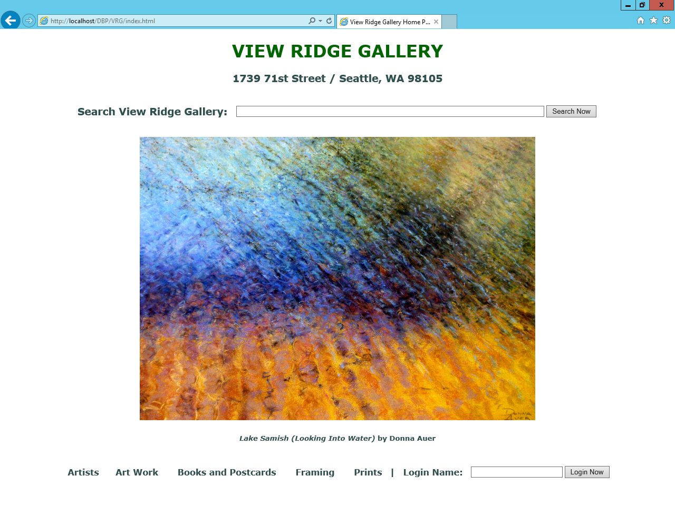
View Ridge Gallery

Slide 7
View Ridge Gallery
View Ridge Gallery is a small art gallery that has been in business for 30 years.
It sells contemporary European and North American fine art.
View Ridge has one owner, three salespeople, and two workers.
View Ridge owns all of the art that it sells; it holds no items on a consignment basis.

Slide 8
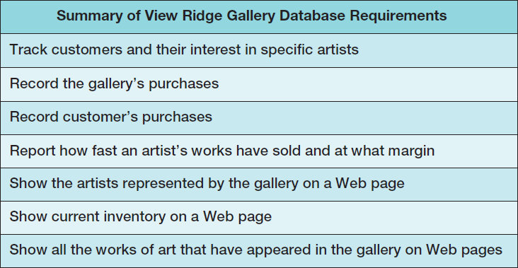
VRG Application Requirements

Slide 9
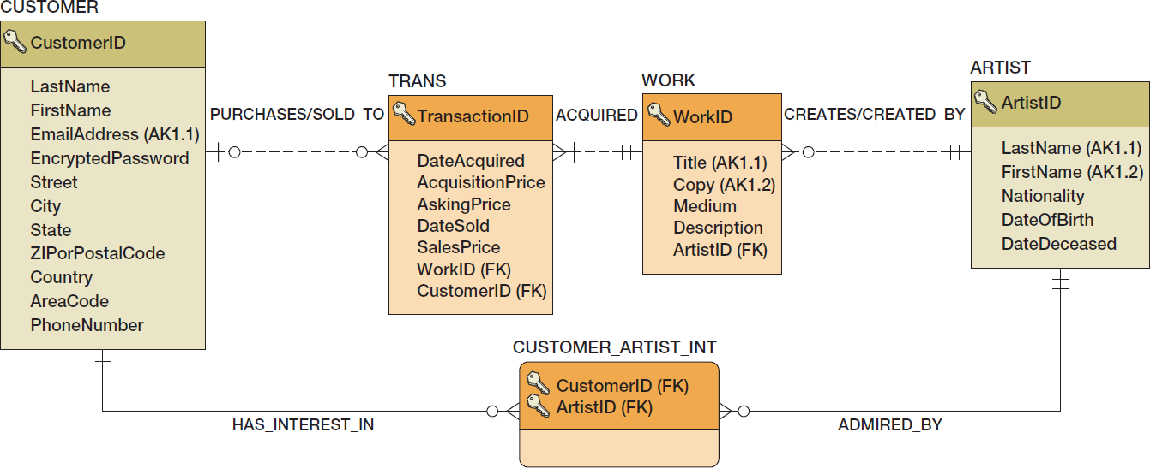
VRG Database Design

Slide 10
Creating the VRG Database
Create the VRG database itself:
For Oracle Database 12c, we use the same steps discussed above to create a VRG tablespace, a VRG_USER user account, and a VRG_DEV role.
For Oracle Database XE, we will use the same steps discussed above to create a VRG_USER Oracle Application Express workspace.
Once we have created the basis for a new connection, we create a VRG-Database connection in SQL Developer.

Slide 11
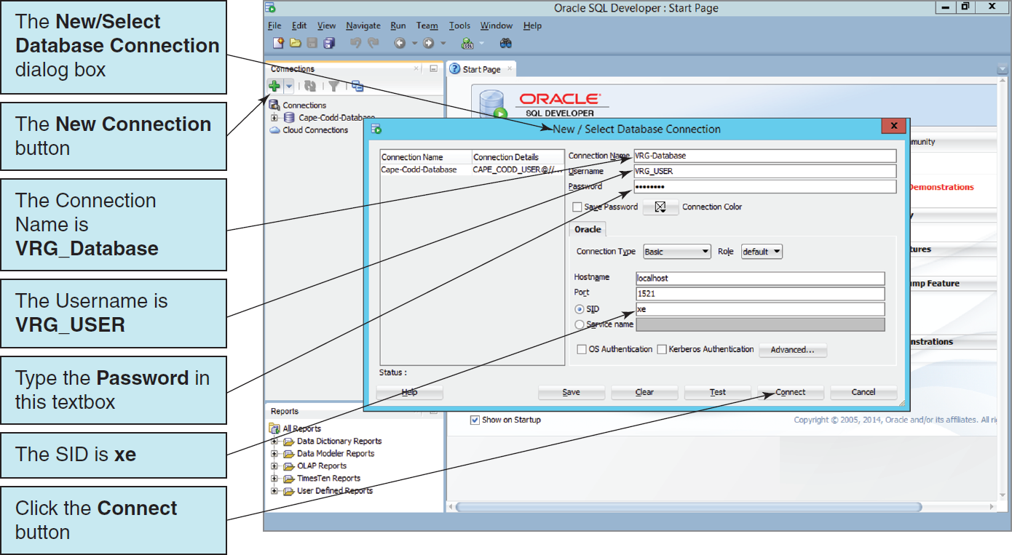
The VRG Database in SQL Developer The VRG-Database Connection in the New/Select Database Connection Dialog Box

Slide 12
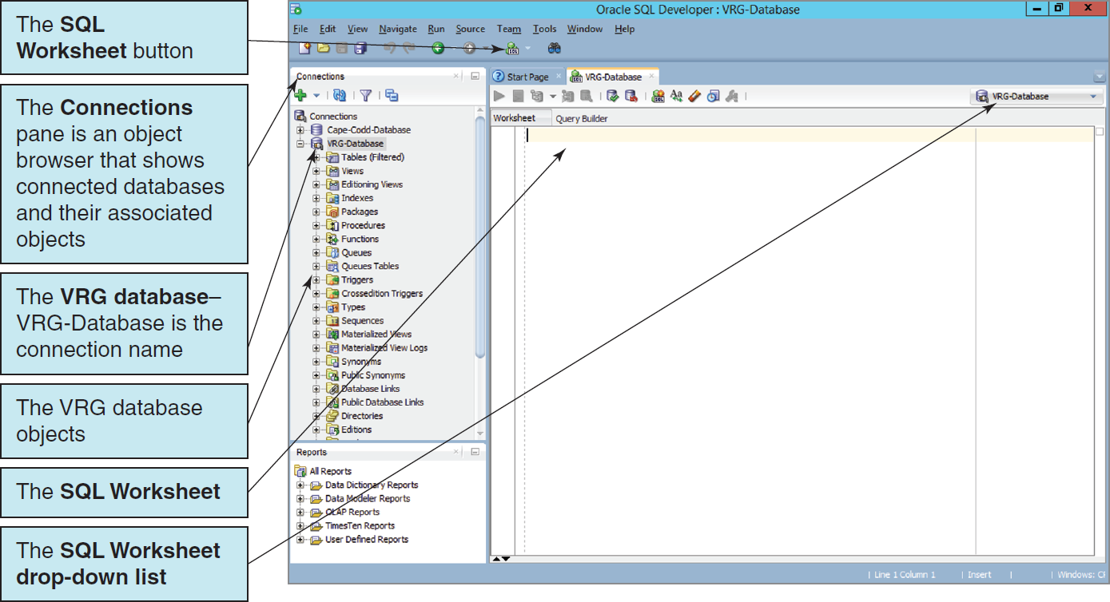
The VRG Database in SQL Developer The VRG-Database Connection in the Connections Pane

Slide 13
SQL Scripts
An SQL script is a plaintext file labeled with the .sql file extension.
An SQL script is composed of one or more SQL statements, which can include SQL script comments.
SQL script comments are lines of text that do not run when the script is executed but are used to document the purpose and contents of the script. Each comment begins with the characters /* (slash asterisk) and ends with the characters */ (asterisk slash). Alternatively, for a single line comment (or a comment at the end of a line), we use – – (two dashes) at the start of the comment.

Slide 14
VRG Database Available Online
The SQL scripts to create and populate the VRG database tables are complex scripts and tedious to reproduce in their complete form.
Versions of the SQL scripts for the complete VRG database are available in the downloadable Student Files available at:
http://www.pearsonhighered.com/kroenke/
These include versions for:
Microsoft SQL Server 2014
Oracle Database 12c and Oracle Database XE
MySQL 5.6
We recommend you actually run all material in a live database!

Slide 15
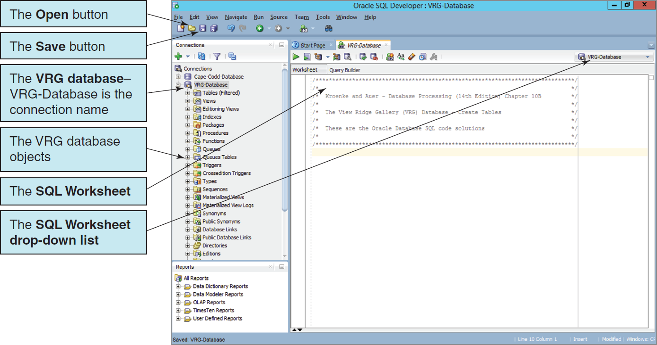
SQL Scripts The VRG Database Script in the SQL Developer

Slide 16
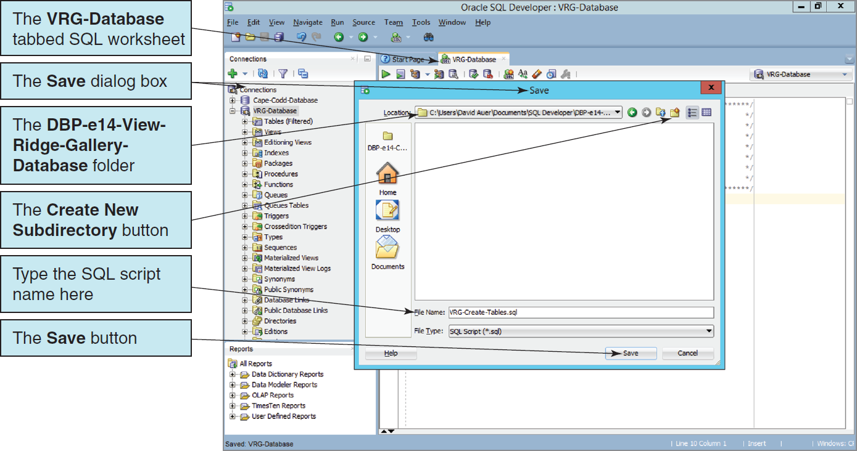
SQL Scripts Saving the SQL Script

Slide 17
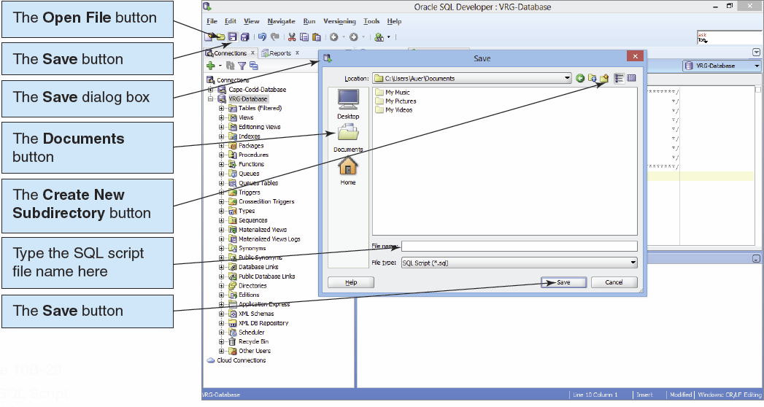
SQL Scripts II

Slide 18
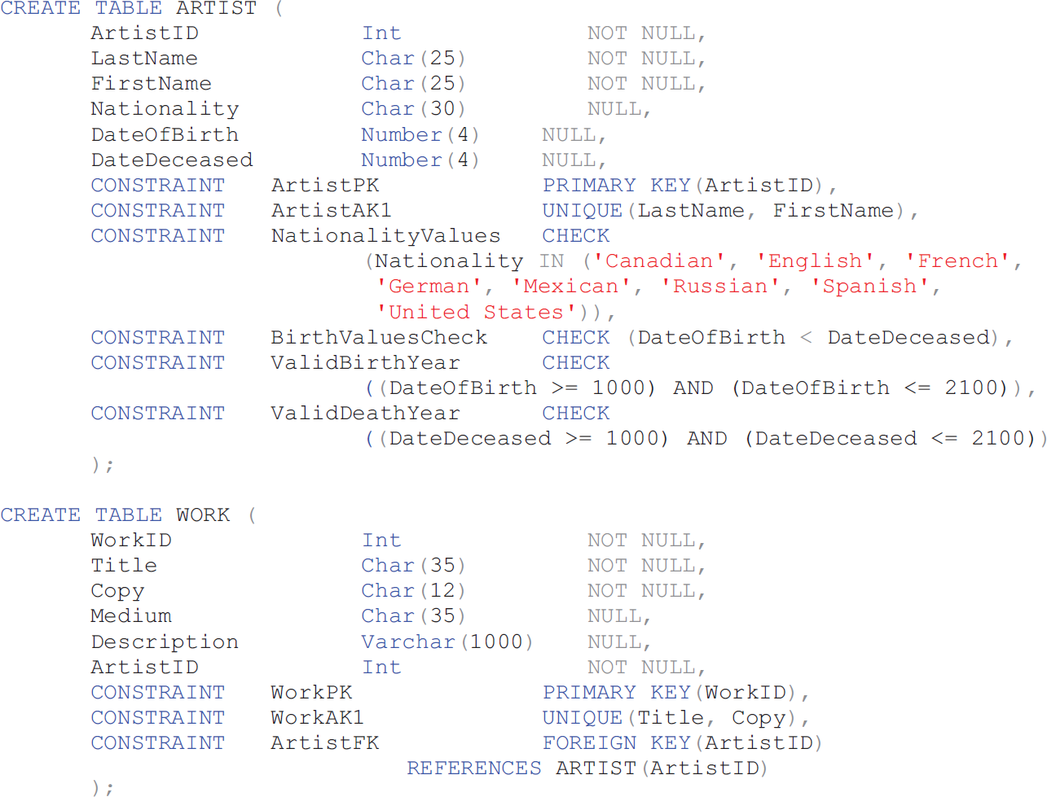
Oracle CREATE TABLE Statements for the VRG Database I

Slide 19
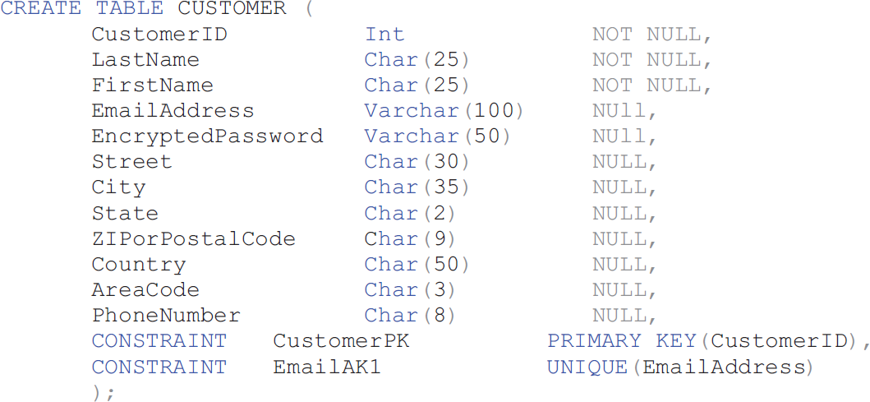
Oracle CREATE TABLE Statements for the VRG Database II

Slide 20
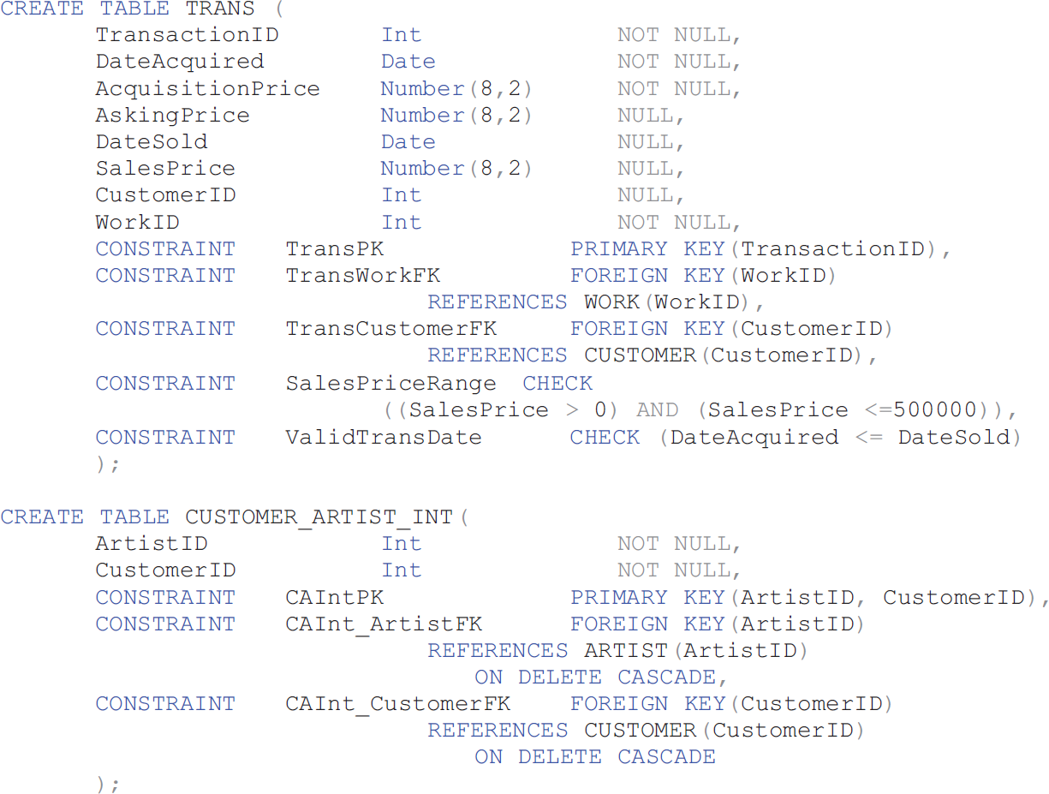
Oracle CREATE TABLE Statements for the VRG Database III

Slide 21
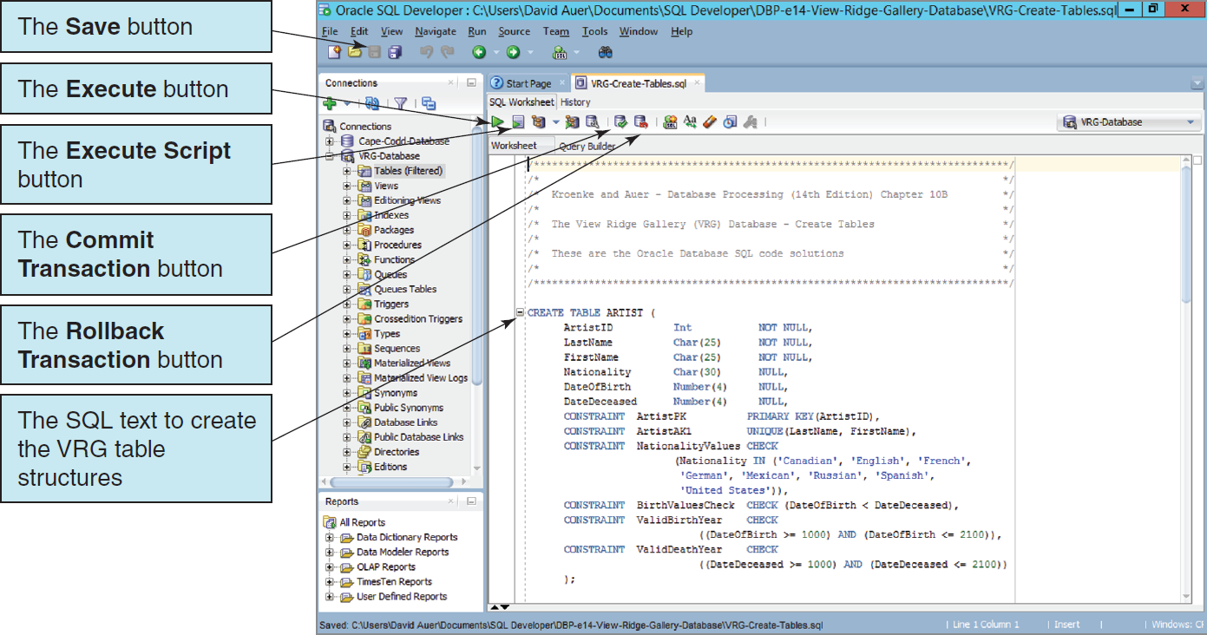
Oracle CREATE TABLE Statements for the VRG Database IV

Slide 22
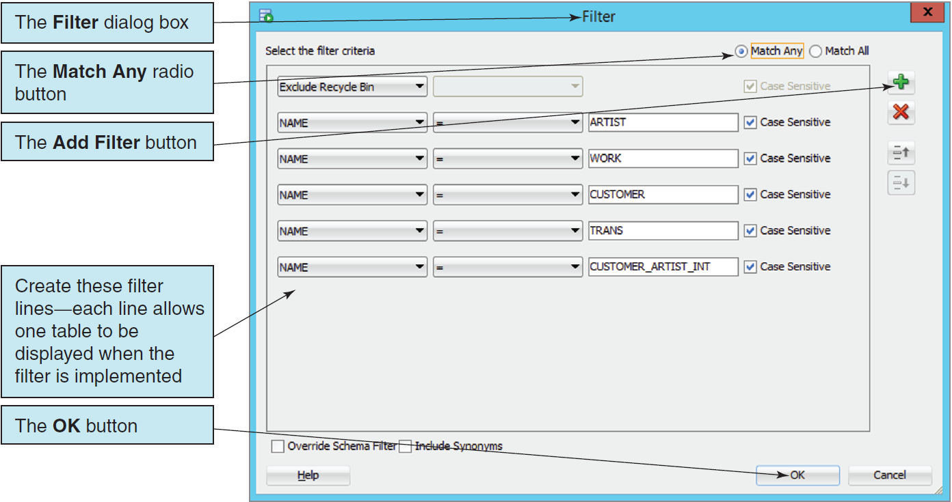
The VRG Database Tables The VRG Database Table Filter

Slide 23
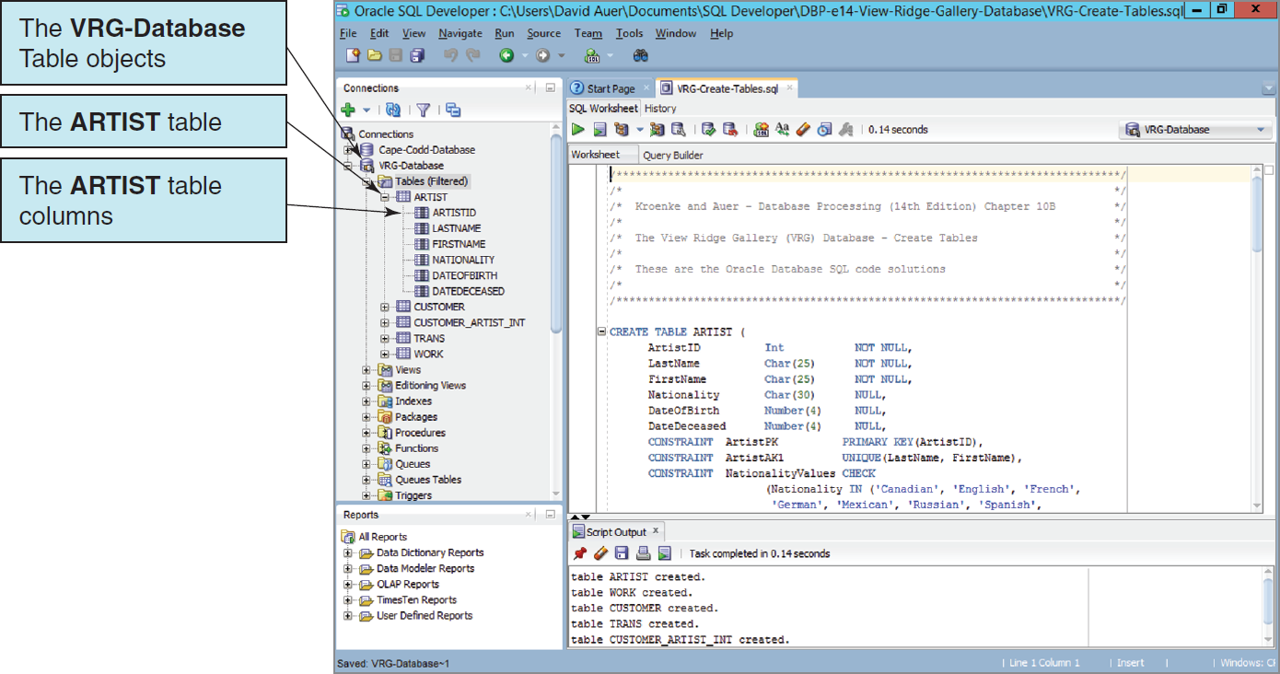
The VRG Database Tables The VRG Database Tables with ARTIST Expanded

Slide 24
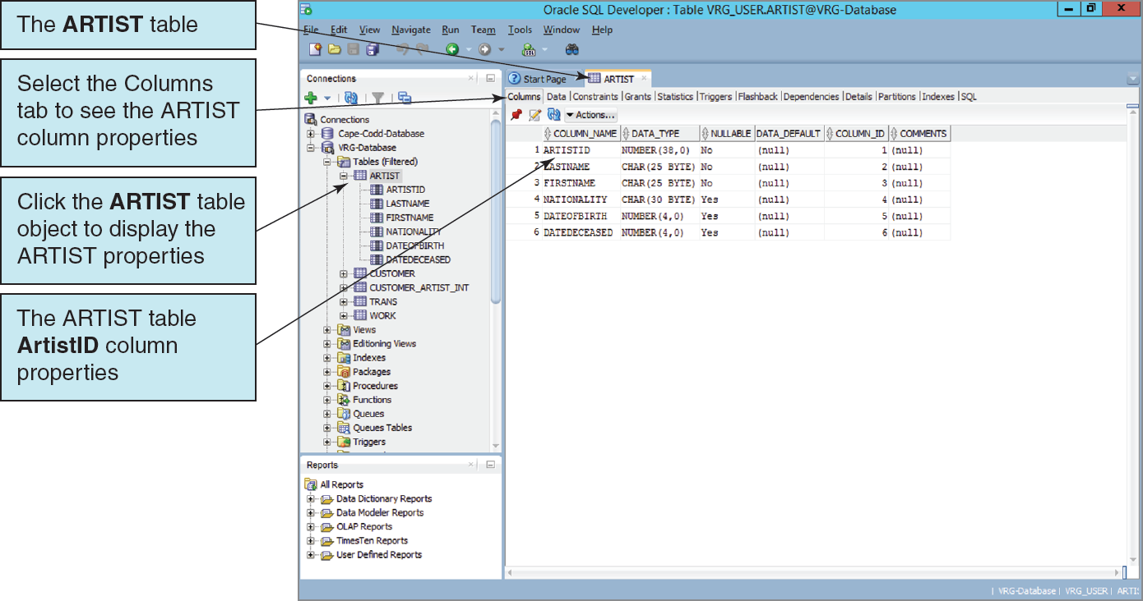
Inspecting Table Properties The ARTIST Table Columns and Column Properties
Notes:
If you look carefully at this figure, you will see that ArtistID is shown as Number (38,0). Recall, however, that in our SQL statements we specified this number as integer (Int).
By definition, integers have no decimal places (i.e., zero decimal places).
Thus, Number (38,0) does designate an integer, and this is how Oracle Database stores integers

Slide 25
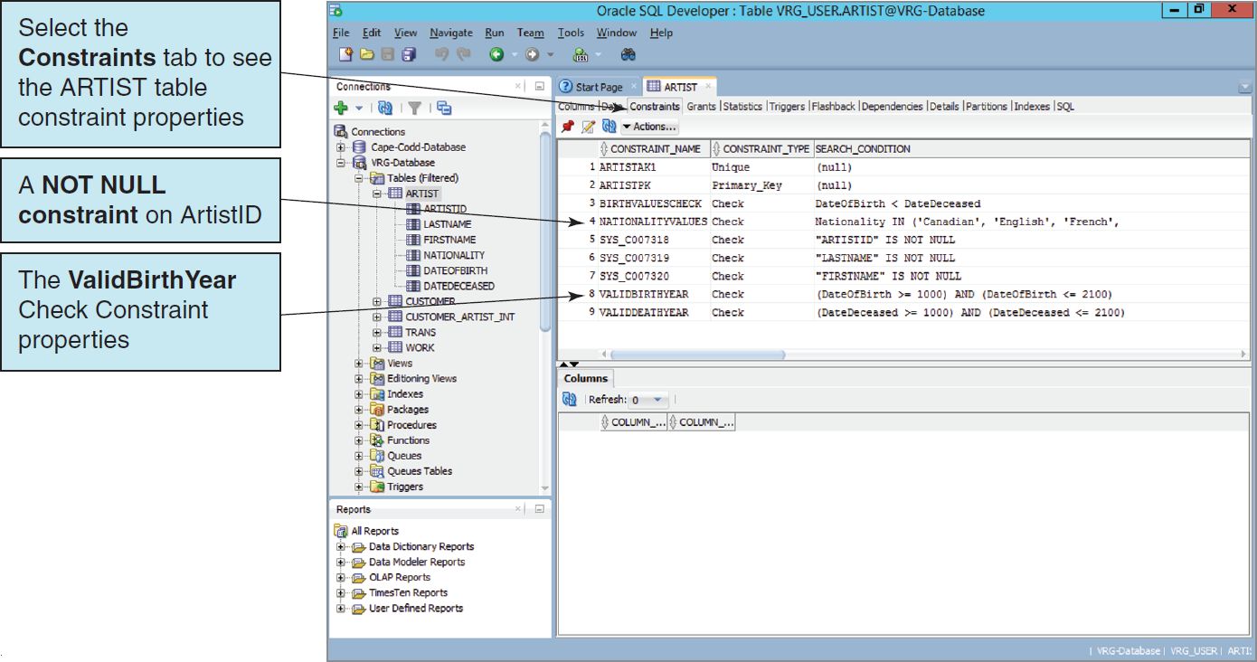
Inspecting Table Properties The ARTIST Table Constraints

Slide 26
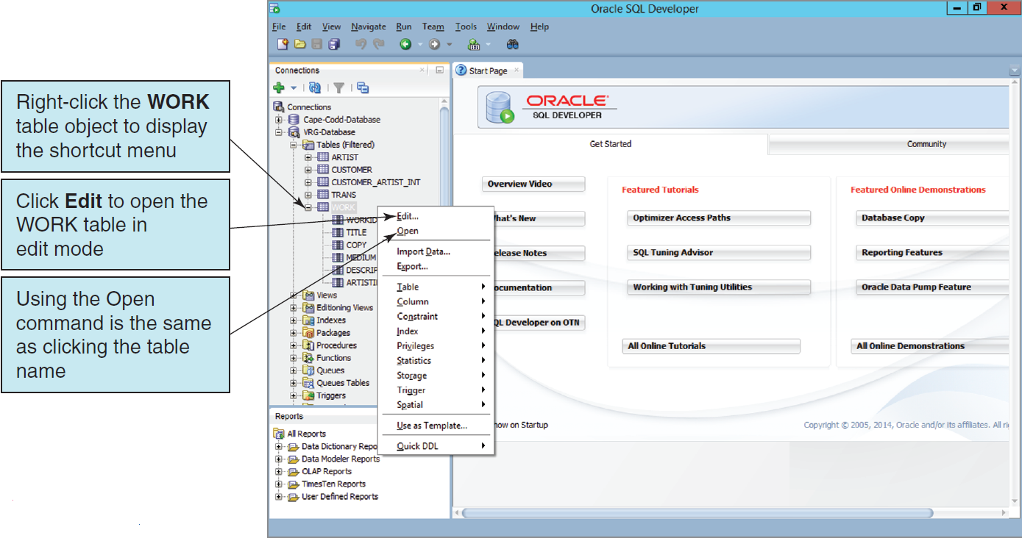
Inspecting Table Properties The Table Shortcut Menu

Slide 27
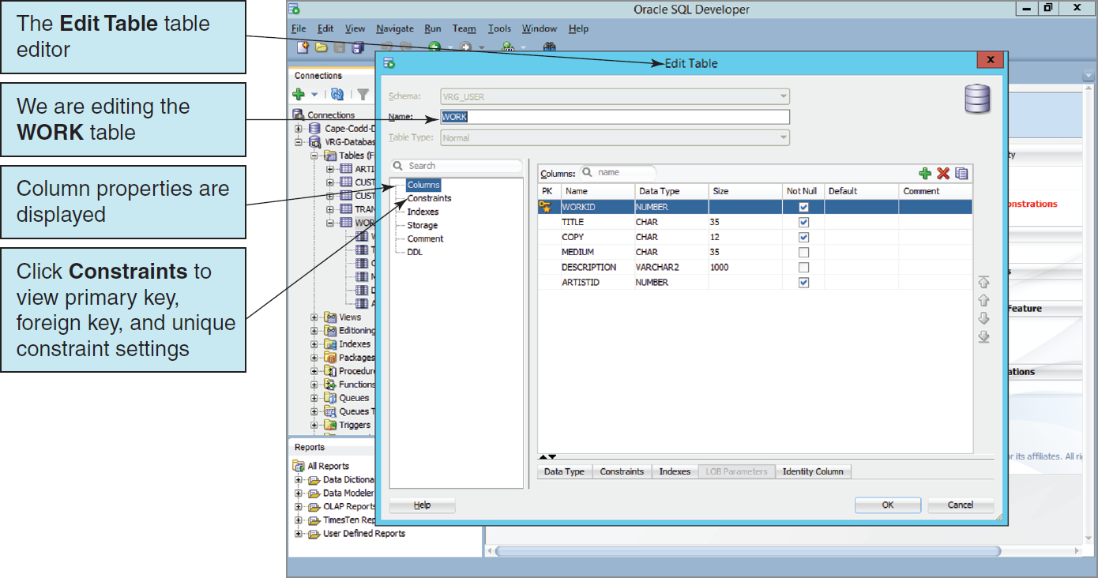
Inspecting Table Properties The Edit Table Table Editor

Slide 28
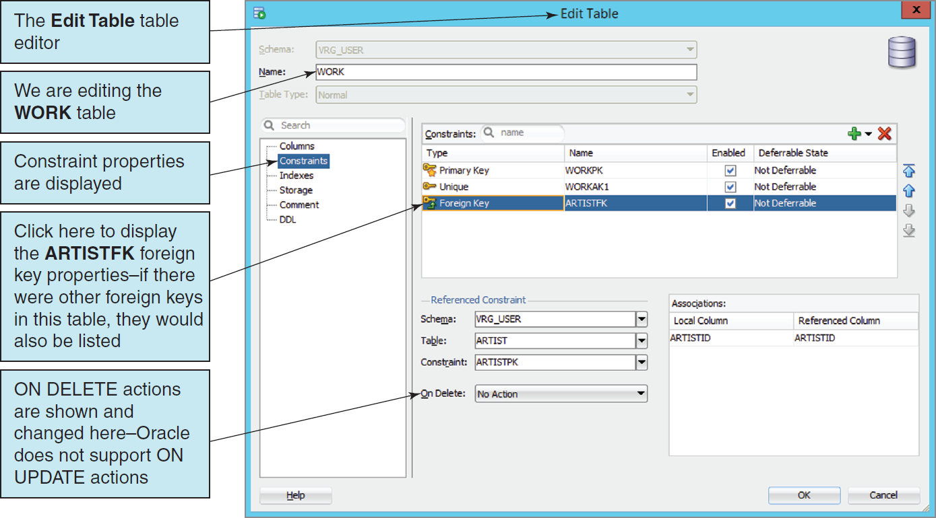
Inspecting Table Properties The WORK Table Constraints

Slide 29
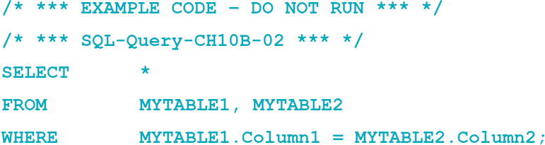
Creating Indexes
Indexes are created to:
Enforce uniqueness on columns
Facilitate sorting
Enable fast retrieval by column values
Good candidates for indexes are columns that are frequently used with equal conditions in WHERE clause or in a join.
Example:

Slide 30
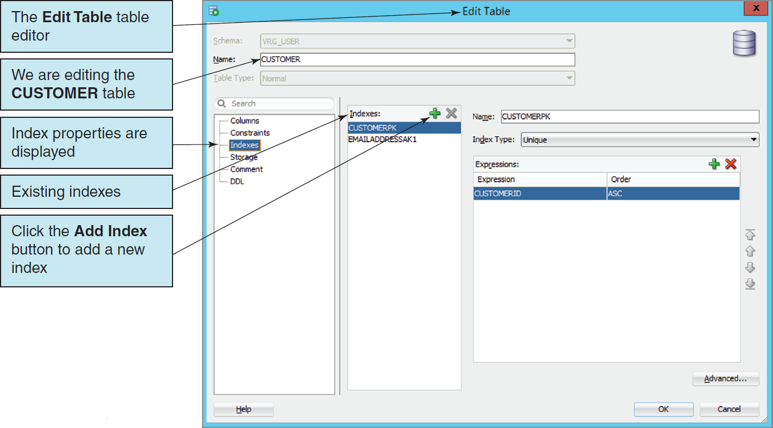
Creating Indexes CUSTOMER Table Indexes

Slide 31
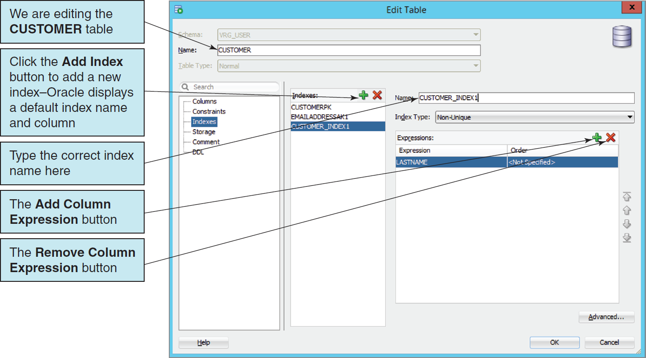
Creating Indexes Creating a New Index

Slide 32
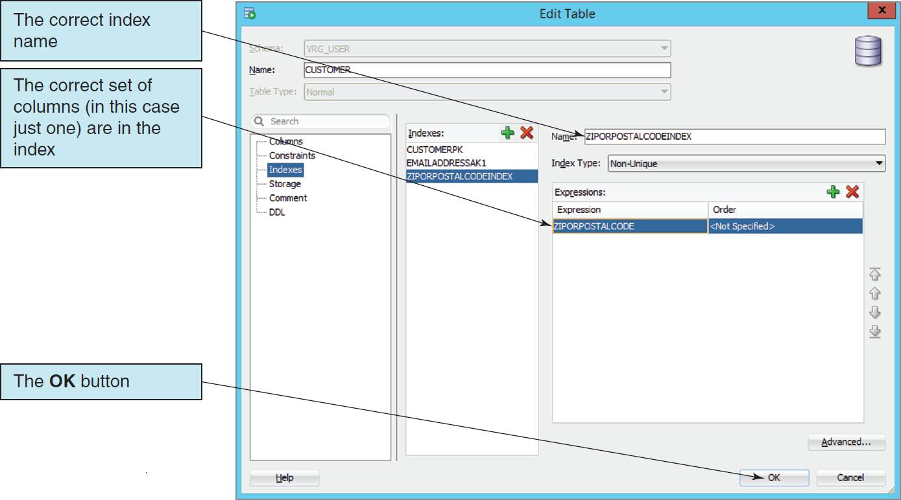
Creating Indexes The ZIPorPostalCodeIndex Index Properties

Slide 33
Oracle Sequences
A sequence is an object that generates a sequential series of unique numbers.
Create Sequence CustID Increment by 1 start with 1000;
It is the best way to work with surrogate keys in Oracle.
Two sequence methods:
NextVal provides the next value in a sequence.
CurrVal provides the current value in a sequence.
Using sequences does not guarantee valid surrogate key values because it is possible to have missing, duplicate, or wrong sequence values in the table.

Slide 34
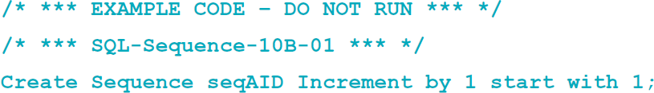
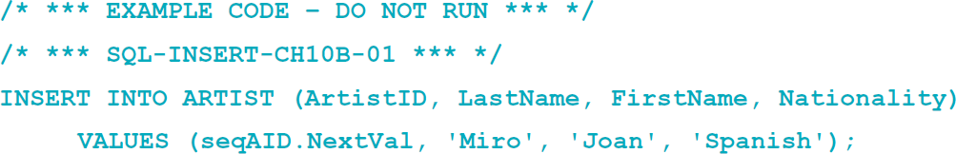
Using Sequences I
Creating a sequence:
Entering data using a sequence:

Slide 35
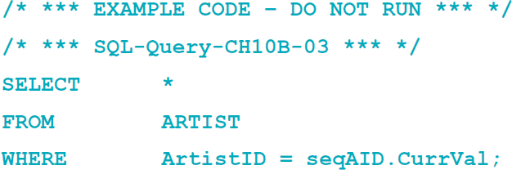
Using Sequences II
Retrieving the row just created:

Slide 36
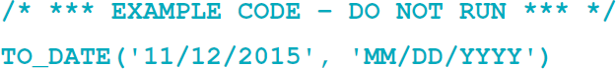
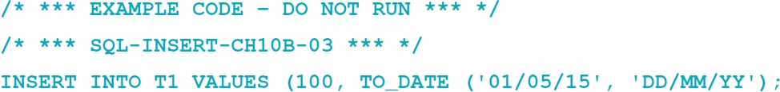
The TO_DATE Function
Oracle requires dates in a particular format.
TO_DATE function may be used to identify the format:
11/12/2011 is the date value.
MM/DD/YYYY is the pattern to be used when interpreting the date.
The TO_DATE function can be used with the INSERT and UPDATE statements to enter data:

Slide 37
Populating the Tables: Working with Non-continuous Primary Key Surrogate Values
The VRG database data contains existing primary key surrogate values that are not continuous.
The VRG tables were coded without using sequences.
Insert the data, then create the sequences using SQL CREATE SEQUENCE statements to create the appropriate sequences with appropriate parameters.
Surrogate values will start at the next available data value on further data inserts.

Slide 38
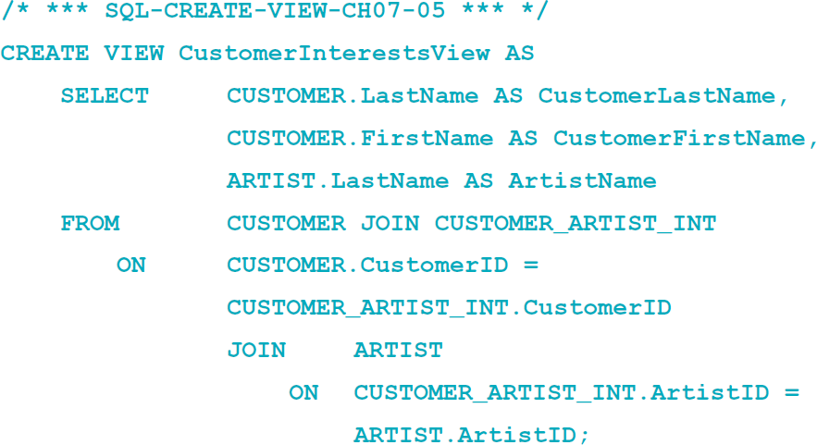
Creating Views
The CREATE VIEW statement can be used to create views in Oracle.
Unlike SQL-92, Oracle allows the ORDER BY clause in view definitions.
Oracle supports the JOIN…ON syntax.
Example:

Slide 39
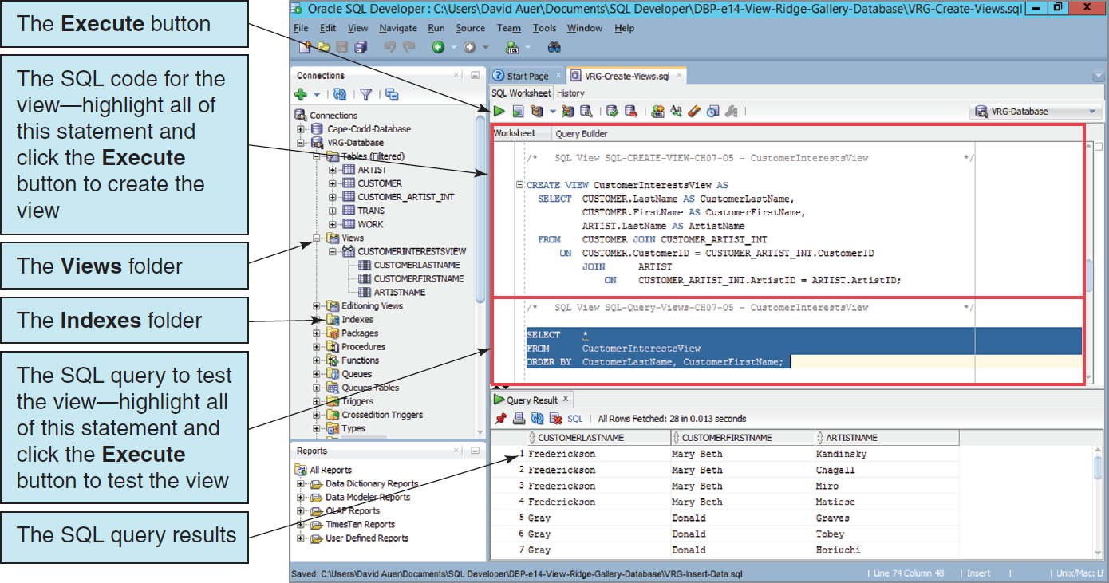
Creating Views Creating an SQL View

Slide 40
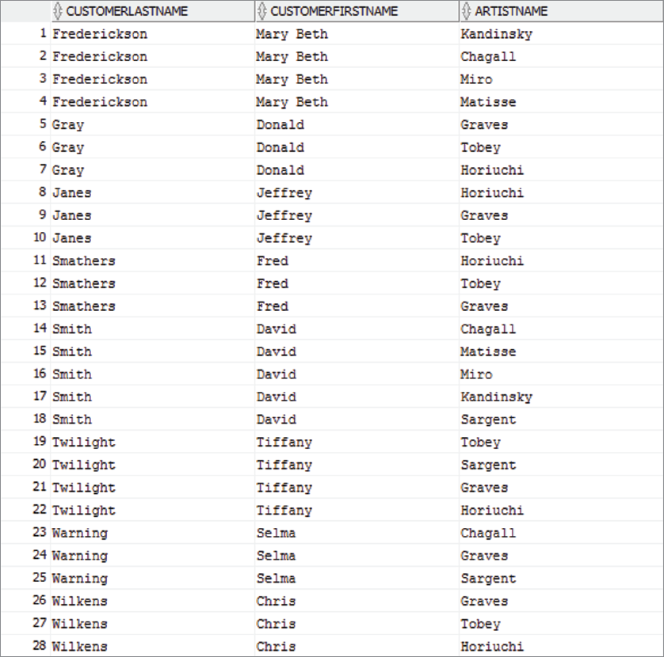
Creating Views Result of Using the View CustomerInterestsView

Slide 41
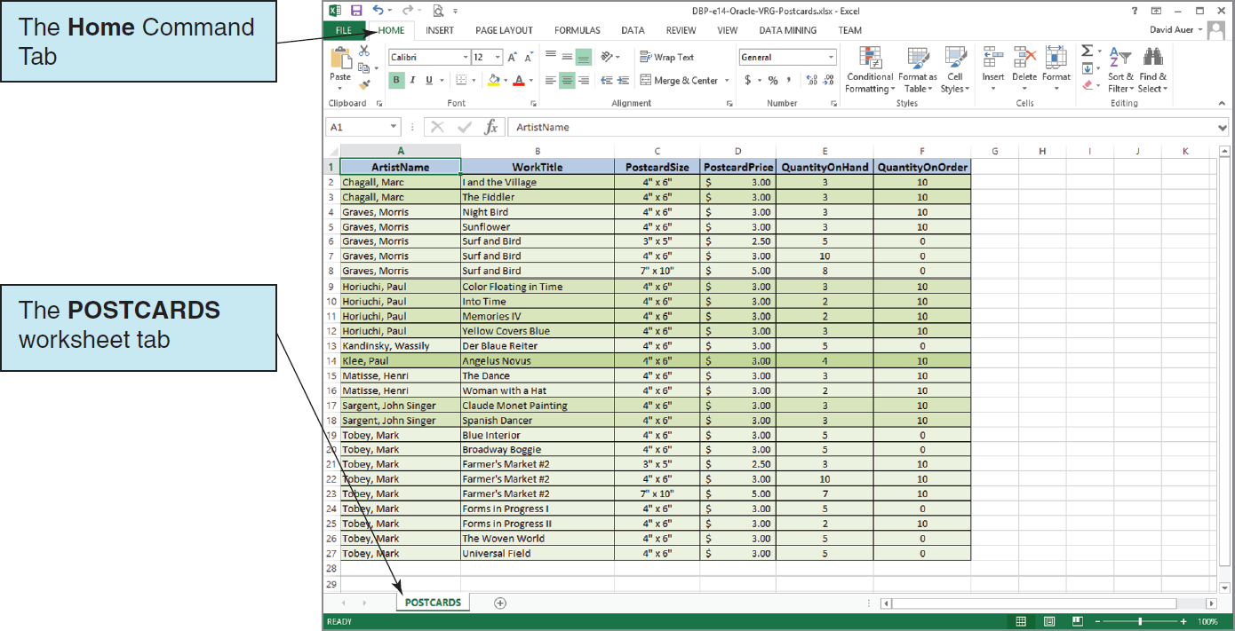
Importing Microsoft Excel Data The Original VRG POSTCARD Worksheet
This worksheet is included in the downloadable Student Files available at: http://www.pearsonhighered.com/kroenke/

Slide 42
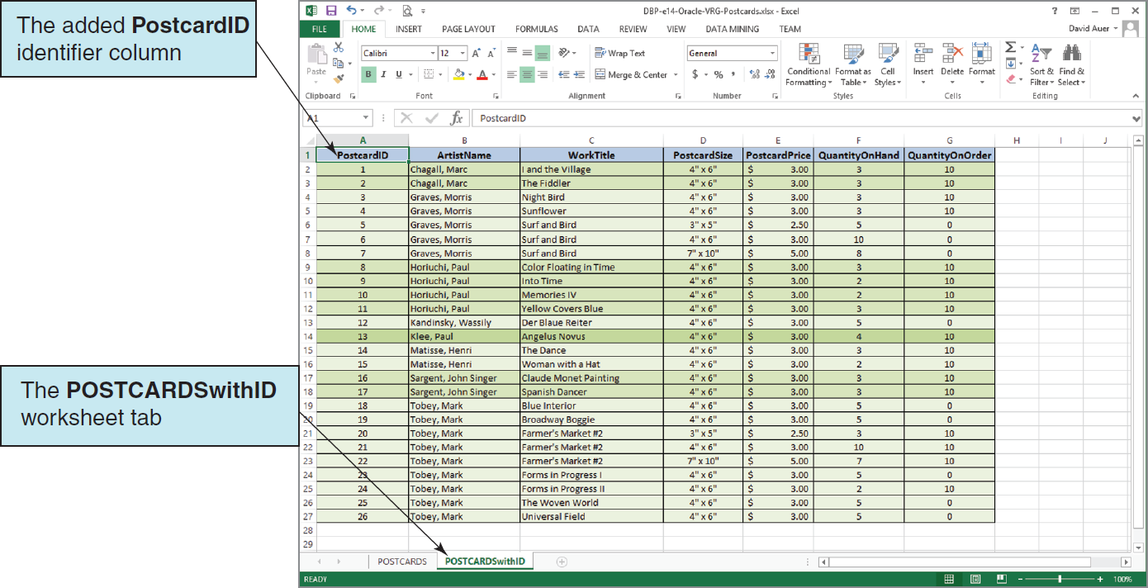
Importing Microsoft Excel Data The Modified VRG POSTCARD Worksheet
This worksheet is included in the downloadable Student Files available at: http://www.pearsonhighered.com/kroenke/

Slide 43
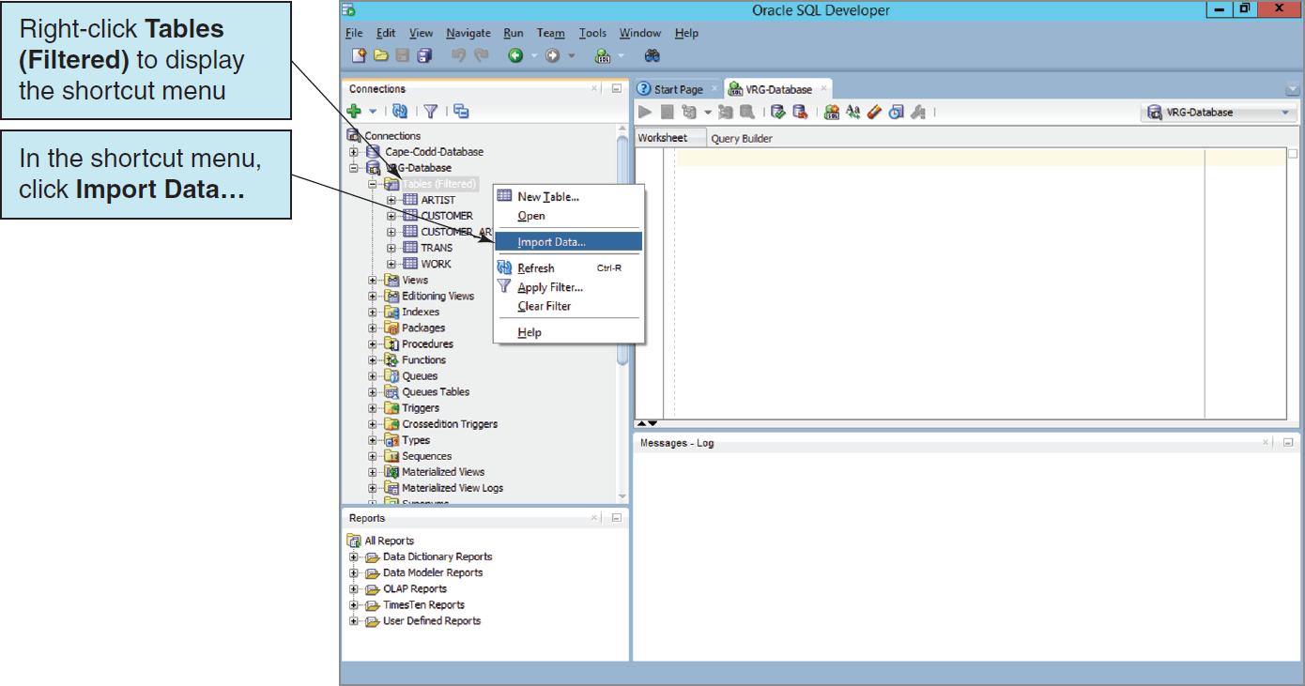
Importing Microsoft Excel Data The Import Data Command

Slide 44
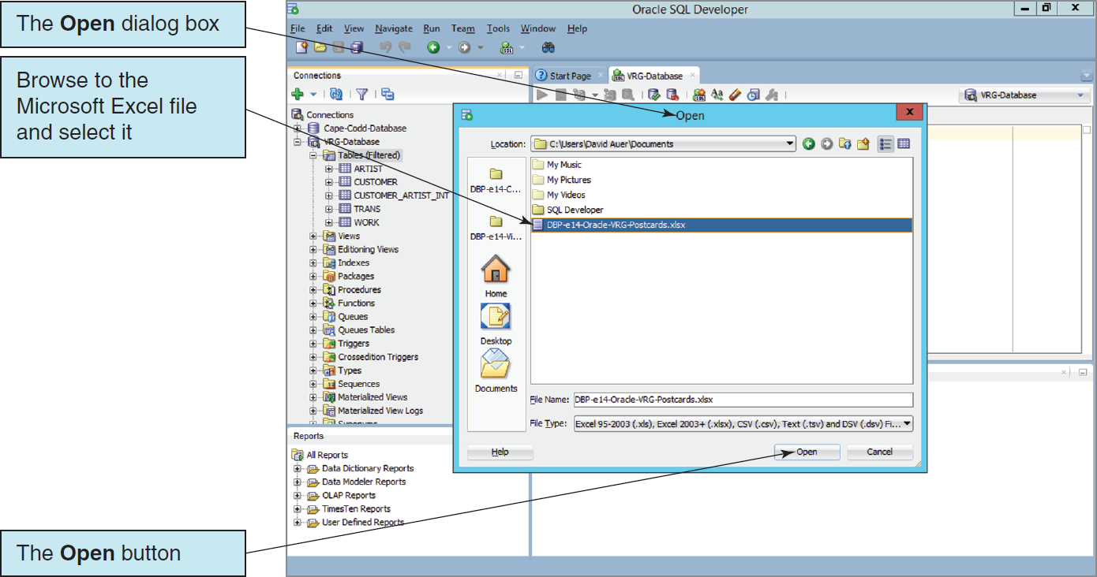
Importing Microsoft Excel Data The Open Dialog Box for the Excel Workbook File

Slide 45
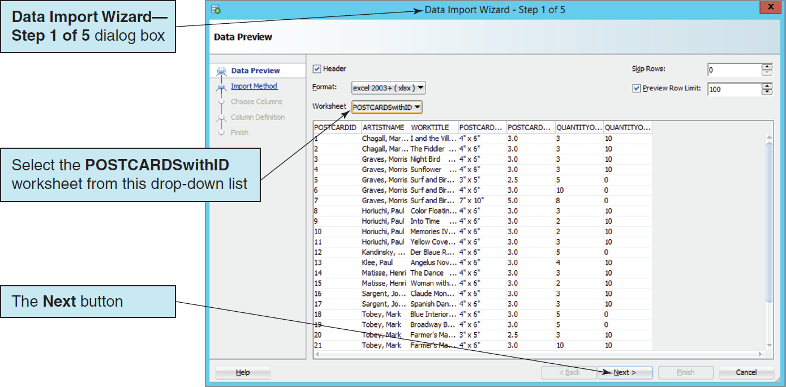
Importing Microsoft Excel Data The Data Import Wizard—Step 1 of 5 Dialog Box

Slide 46
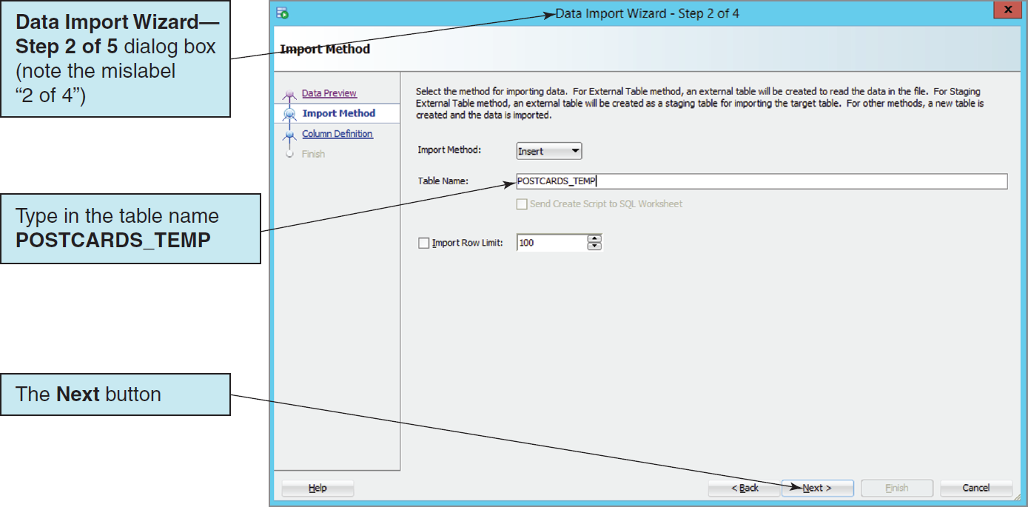
Importing Microsoft Excel Data The Data Import Wizard—Step 2 of 5 Dialog Box

Slide 47
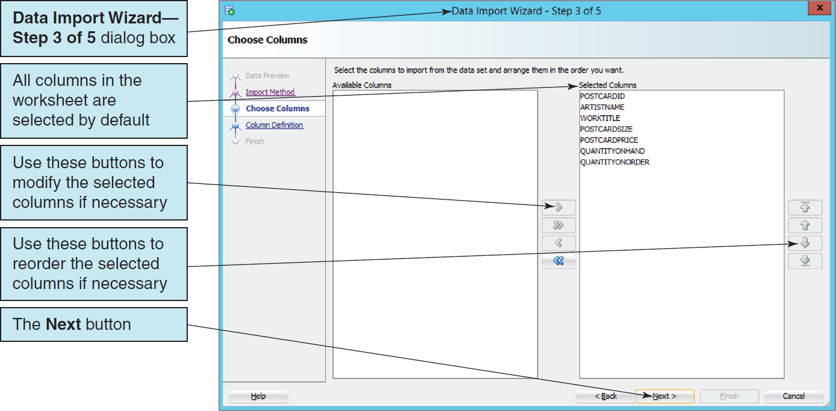
Importing Microsoft Excel Data The Data Import Wizard—Step 3 of 5 Dialog Box

Slide 48
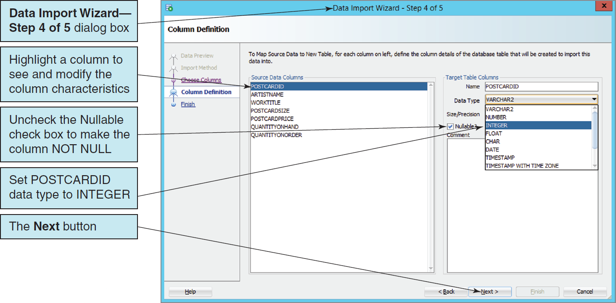
Importing Microsoft Excel Data The Data Import Wizard—Step 4 of 5 Dialog Box

Slide 49
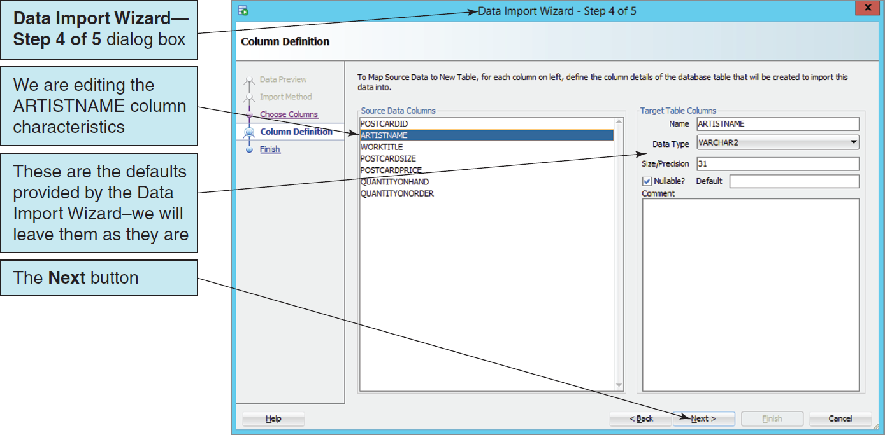
Importing Microsoft Excel Data The Column Definition for ARTISTNAME

Slide 50
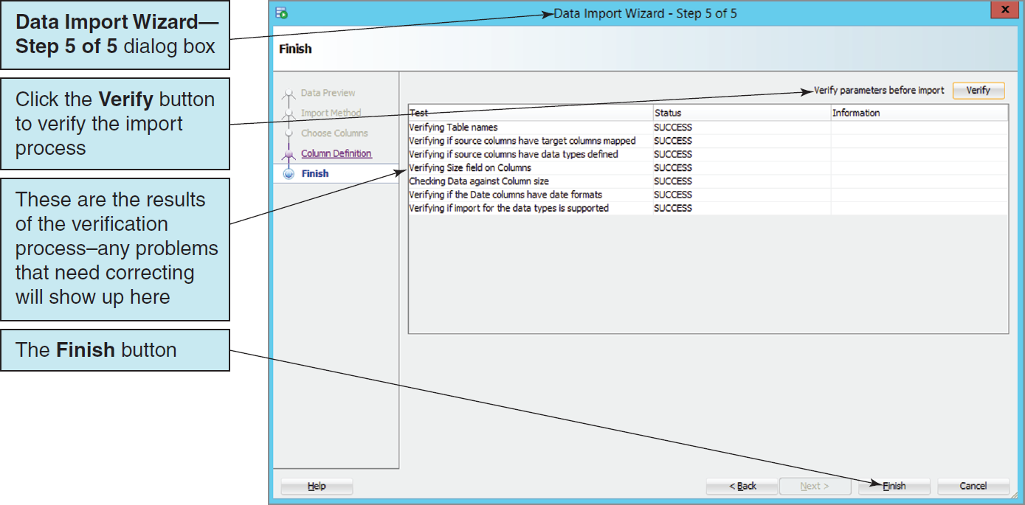
Importing Microsoft Excel Data The Data Import Wizard—Step 5 of 5 Dialog Box

Slide 51
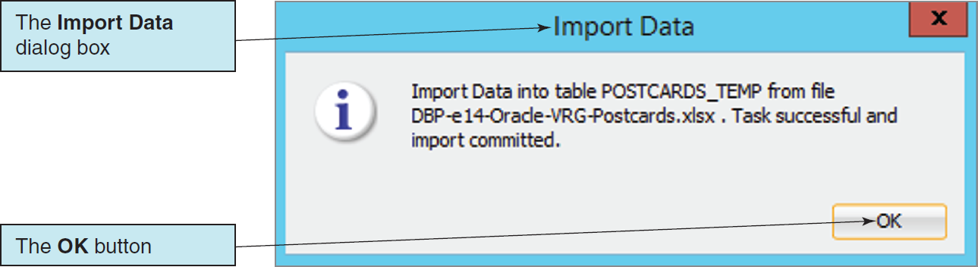
Importing Microsoft Excel Data The Import Data Dialog Box

Slide 52
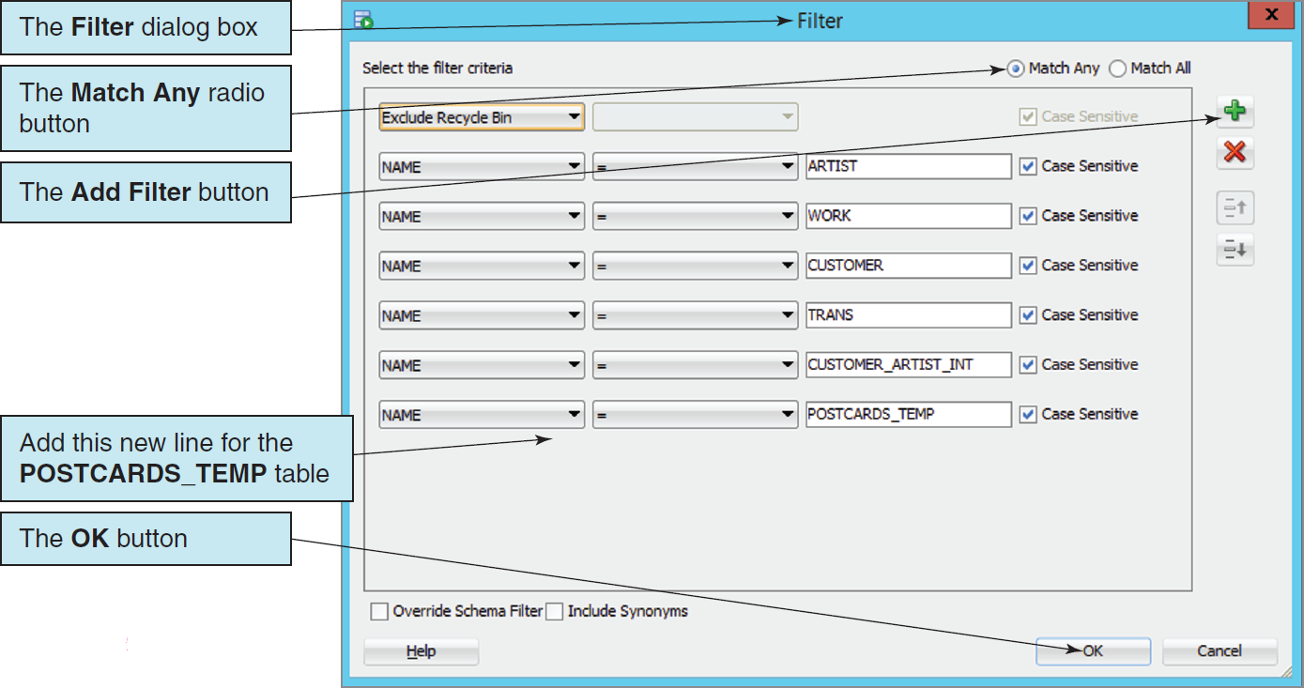
Importing Microsoft Excel Data Modifying the Table Filter

Slide 53
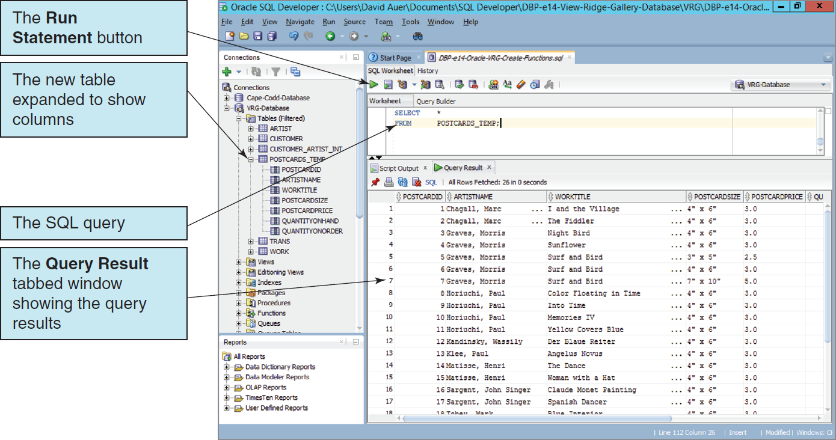
Importing Microsoft Excel Data The POSTCARDS_TEMP Table

Slide 54
Application Logic I
Oracle Database implements the SQL/Persistent Stored Modules (SQL/PSM) standard in the Oracle Database Procedural Language/SQL (PL/SQL).
Oracle Database also supports the use of the Java programming language for writing Oracle Database functions, stored procedures and triggers.

Slide 55
Application Logic II
Oracle database applications can be processed using:
Programming languages to invoke DBMS commands
The SQL*Plus Command Line utility to invoke database commands stored in .sql files
The SQL Developer to invoke database commands stored in .sql files
Stored procedures
Triggers

Slide 56
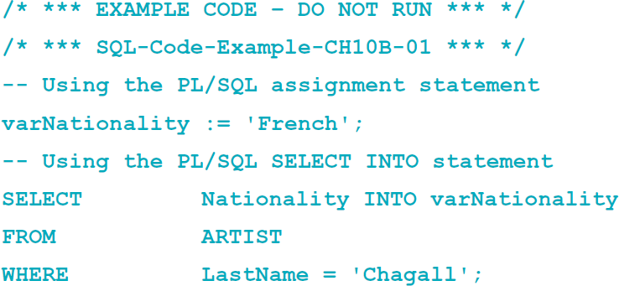
Application Logic Parameters and Variables
A parameter is a value passed to a user-defined function or stored procedure.
A variable is a value used within a user-defined function, trigger or stored procedure.

Slide 57
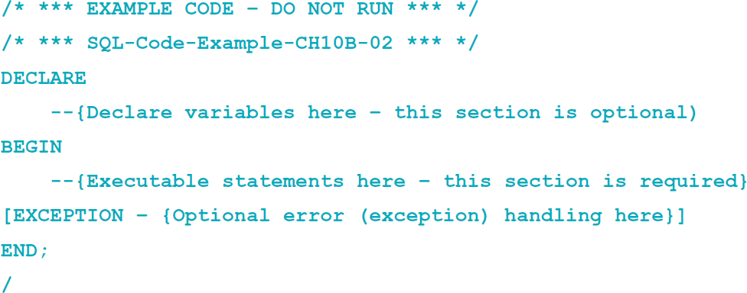
Application Logic Oracle Block Structure
Oracle blocks must end with a single slash (/) as a signal to compile and execute the code to create the procedure or trigger:
This is a slash (/)

Slide 58
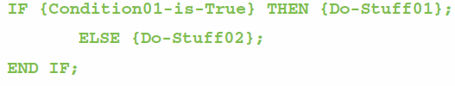
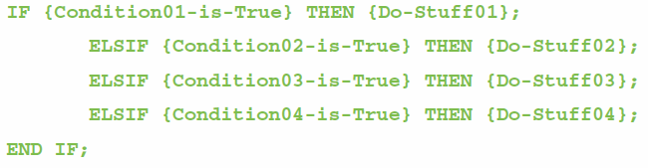
Application Logic: Oracle Control of Flow Statements I
IF…THEN…ELSE…END IF
IF…ELSIF…END IF

Slide 59
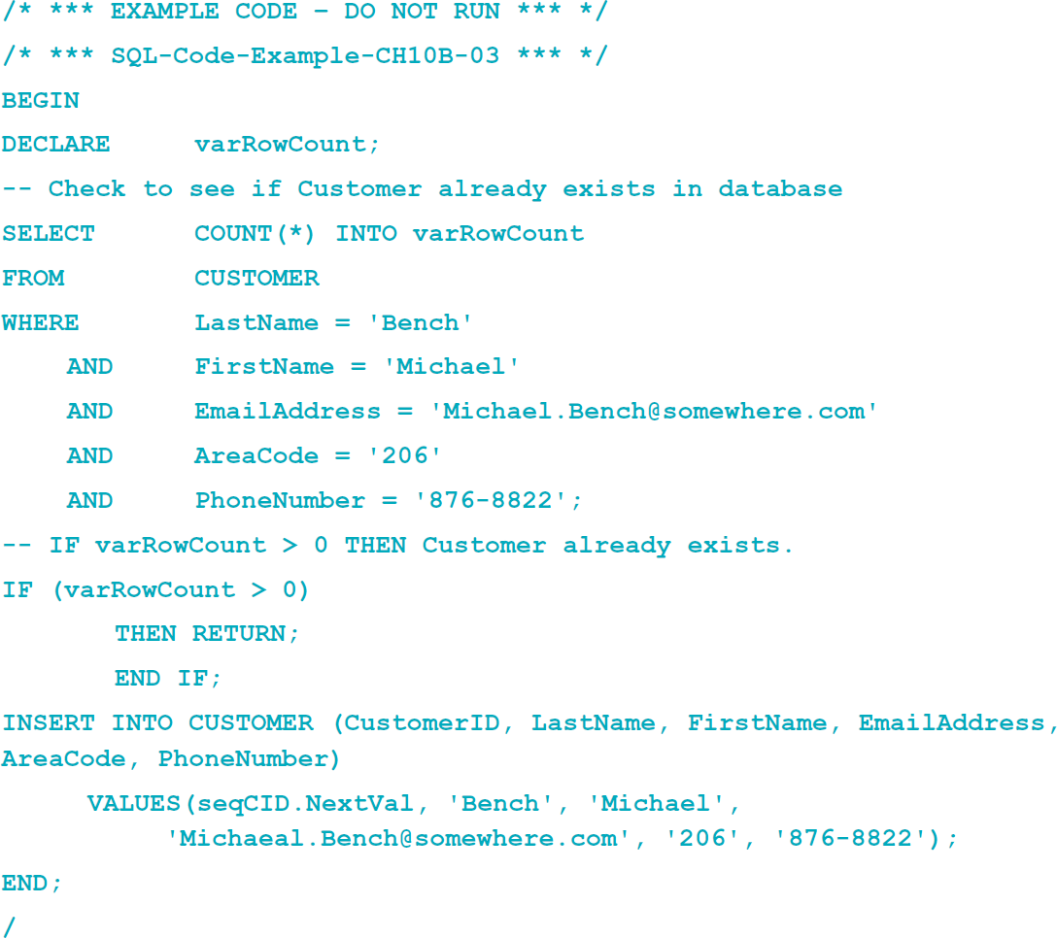
Application Logic: Oracle Control of Flow Statements II
BEGIN…END
RETURN

Slide 60
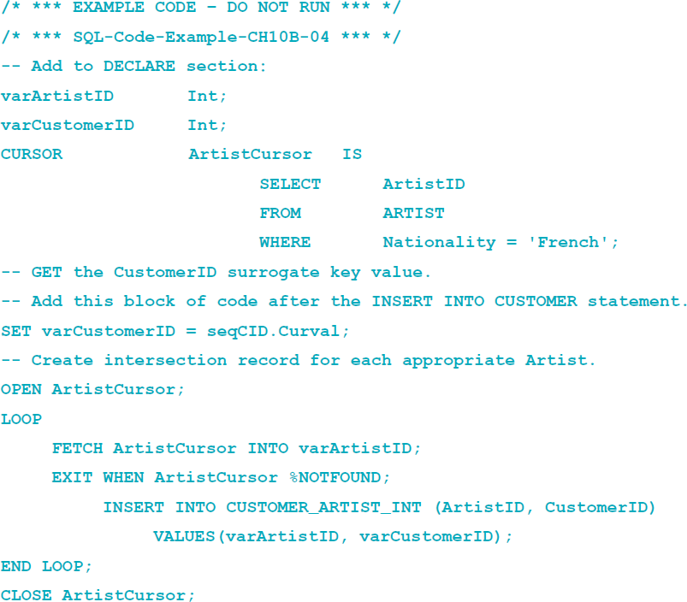
Application Logic: Oracle Cursor Statements
DECLARE
OPEN
FETCH
LOOP
FOR
WHILE
EXIT WHEN
CLOSE

Slide 61

Application Logic: Oracle Output Statements
Oracle uses the
DBMS_OUTPUT.PUT_LINE ({text here})
statement for output.
To use this statement, you must first execute:

Slide 62
SQL/Persistent Stored Modules (SQL/PSM)
SQL/Persistent Stored Modules (SQL/PSM) is an ANSI/ISO standard for embedding procedural programming functionality into SQL.
Each DBMS product implements SQL/PSM in a different way, with some closer to the standard than others.
Microsoft SQL Server 2014 calls its version Transact-SQL (T-SQL).
Oracle Database calls its variant Procedural Language/SQL (PL/SQL).
MySQL 5.6 implements SQL/PSM, but has no special name for its variant of SQL.

Slide 63

User-Defined Functions
A user-defined function (stored function) is a stored set of SQL statements that:
is called by name from another SQL statement
may have input parameters passed to it by the calling SQL statement, and
returns an output value to the SQL statement that called the function.

Slide 64

User-Defined Functions The FirstNameFirst Function

Slide 65

User-Defined Functions The FirstNameFirst Function
Using the FirstNameFirst function:

Slide 66

User-Defined Functions IV The FirstNameFirst Function
FirstNameFirst function results:

Slide 67
User-Defined Functions Additional Character String Functions
The INSTR function returns the numeric position of a character:
The SUBSTR function returns a specified subset of the characters in a character string:

Slide 68

User-Defined Functions The GetLastNameCommaSeparated Function

Slide 69

User-Defined Functions The GetLastNameCommaSeparated Function
Using the GetLastNameCommaSeparated function:

Slide 70

User-Defined Functions The GetLastNameCommaSeparated Function
GetLastNameCommaSeparated function results:

Slide 71
Stored Procedures I
A stored procedure is a PL/SQL or Java program stored within the database.
Stored procedures are programs that can:
Have parameters.
Invoke other procedures and functions.
Return values.
Raise exceptions.
A stored procedure must be compiled and stored in the database.
Notes:
The first time you create a stored procedure in an SQL script, you use the SQL CREATE PROCEDURE statement.
In Oracle, however, always use the phrase CREATE OR REPLACE in this statement when developing PL/SQL procedures to allow for changes to the procedure.
Use the SQL DROP PROCEDURE statement to delete the procedure.

Slide 72

Stored Procedures I
The CALL command is used to invoke a stored procedure:

Slide 73


Slide 74


Slide 75

Running Stored Procedures

Slide 76
Triggers
An Oracle trigger is a PL/SQL or Java procedure that is invoked when a specified database activity occurs.
Triggers can be used to:
Set default values.
Enforce a Data Constraint.
Update a view.
Enforce referential integrity action.
Handle exceptions.

Slide 77
Triggers
Trigger types:
A command trigger will be fired once per SQL command.
A row trigger will be fired once for every row involved in the processing of an SQL command.
There are three types of row triggers: BEFORE, AFTER, and INSTEAD OF.
BEFORE and AFTER triggers are placed on tables while INSTEAD OF triggers are placed on views.
Each trigger can be fired on INSERT, UPDATE, or DELETE commands.

Slide 78

Triggers Comparison

Slide 79


Slide 80


Slide 81

Running Triggers

Slide 82
Concurrency Control
Oracle processes database changes by maintaining a System Change Number (SCN).
SCN is a database-wide value that is incremented by Oracle when database changes are made.
With SCN, SQL statements always read a consistent set of values; those that were committed at or before the time the statement was started.
Oracle only reads committed changes; it will never read dirty data.

Slide 83

Oracle Transaction Isolation

Slide 84
Oracle Recovery Facilities
Three file types for Oracle recovery:
Datafiles contain user and system data.
ReDo log files contain logs of database changes.
Online ReDo files are maintained on disk and contain the rollback segments from recent database changes.
Offline or Archive ReDo files are backups of the Online ReDo files.
Control files describe the name, contents, and locations of various files used by Oracle.

Slide 85
Oracle Recovery Facilities
Oracle can operate in either ARCHIVELOG or NOARCHIVELOG mode:
If running in ARCHIVELOG mode, Oracle logs all changes to the database.
When the Online ReDo files fill up, they are copied to the Archive ReDo files.
The Oracle Recovery Manager (RMAN) is a utility program used to create backups and to perform recovery.

Slide 86
Types of Failure
Oracle recovery techniques depend on the type of failure:
An application failure due to application logic errors.
An instance failure occurs when Oracle itself fails due to an operating system or computer hardware failure.
Oracle can recover from application and instance failure without using the archived log file.
A media failure occurs when Oracle is unable to write to a physical file because of a disk failure or corrupted files.
The database is restored from a backup.

Slide 87
Oracle Backup Facilities
Two kinds of backups:
A consistent backup: database activity must be stopped and all uncommitted changes have been removed from the datafiles
Cannot be done if the database supports 24/7 operations.
An inconsistent backup: backup is made while Oracle is processing the database
An inconsistent backup can be made consistent by processing an archive log file.

Slide 88
David Kroenke and David Auer Database Processing Fundamentals, Design, and Implementation (14th Edition)
End of Presentation:
Chapter Ten B Part 2

Slide 89

All rights reserved. No part of this publication may be reproduced, stored in a retrieval system, or transmitted, in any form or by any means, electronic, mechanical, photocopying, recording, or otherwise, without the prior written permission of the publisher. Printed in the United States of America.

